Slide 1

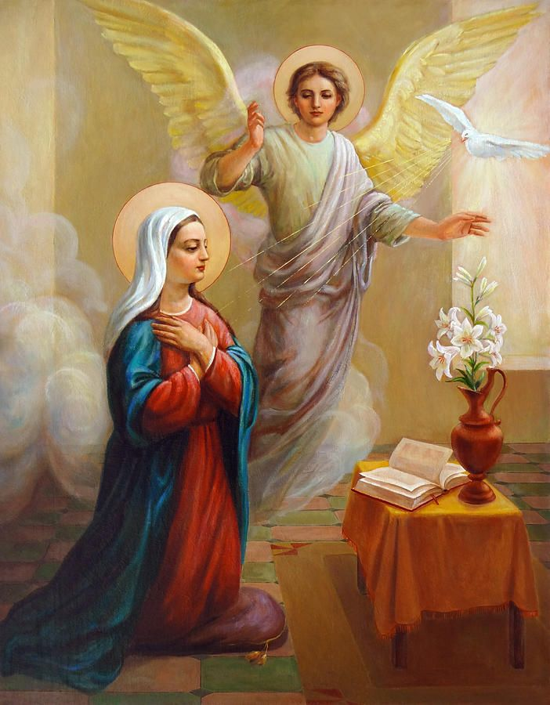
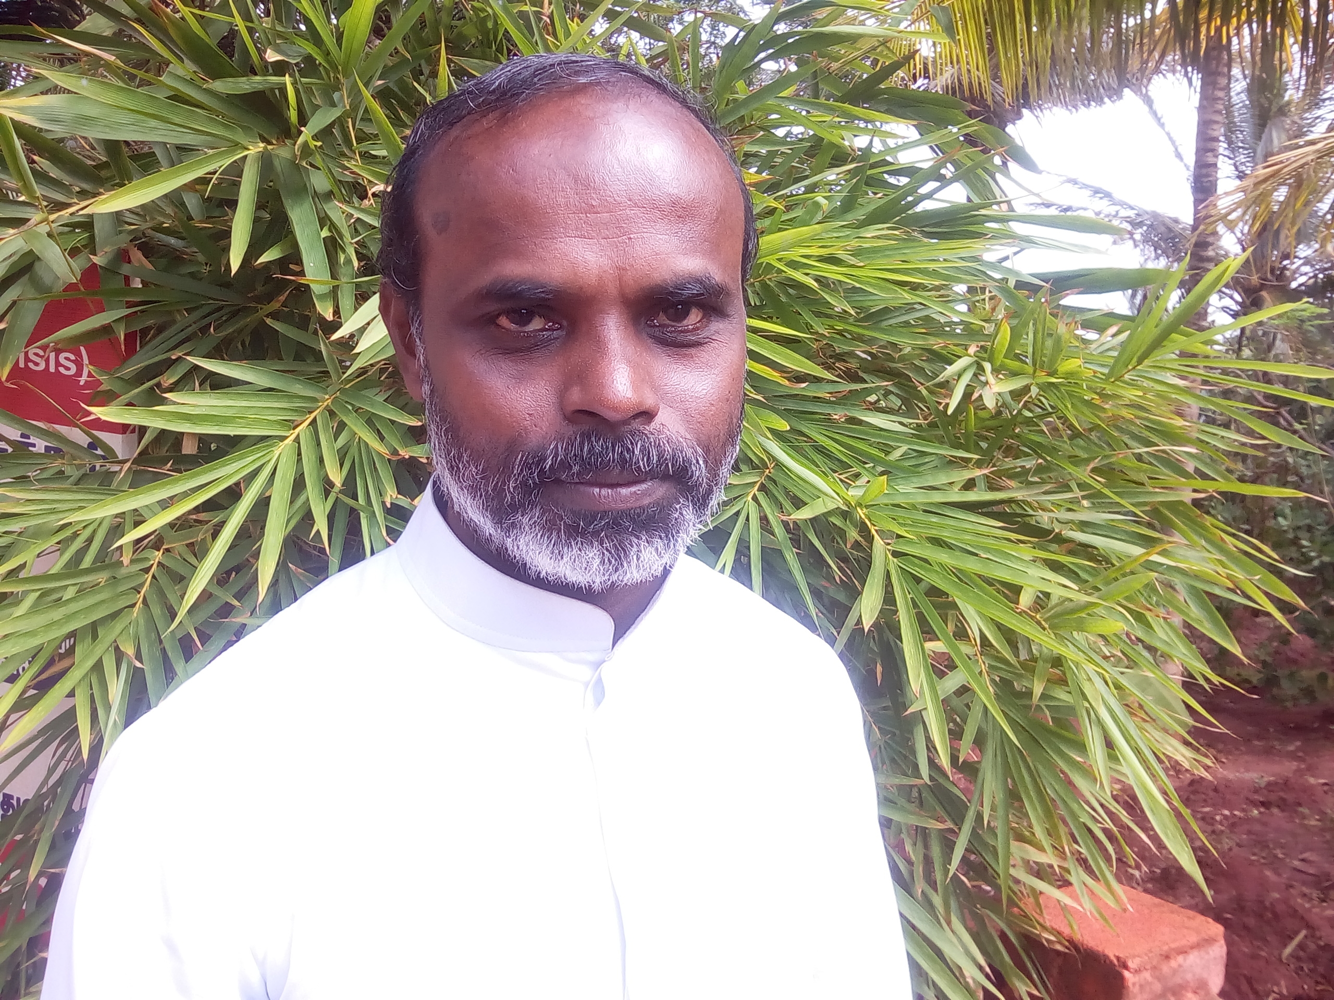
PEACE AND BROTHERHOOD OF INSTITUTE VOLUNTAS DEI
TAMIL NADU REGION @ INDIA
General Assembly - 2022
Fr. John Churchil Bas, IVDEI
Regional Director

Slide 2
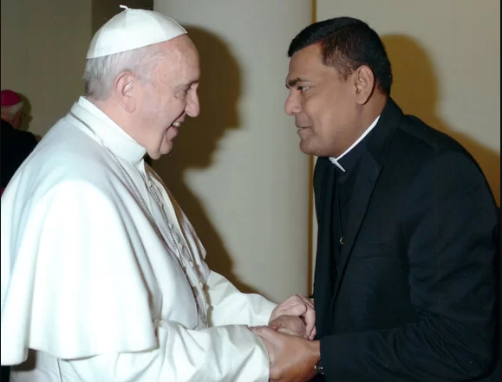
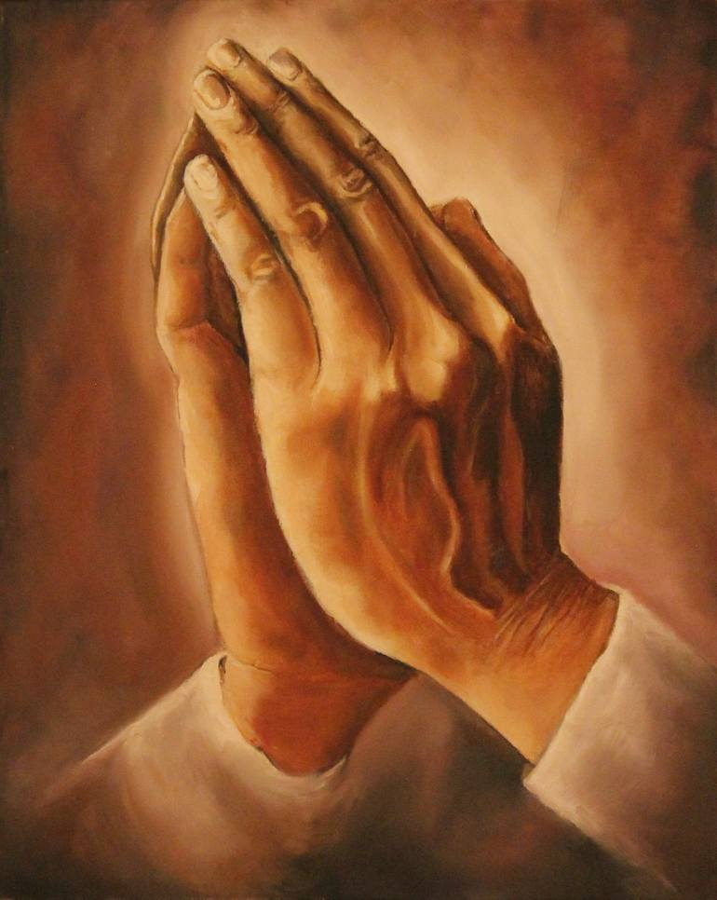
GRATITUDE
Brothers and sisters for enabling us to walk in the footsteps of Jesus Christ.
Rev. Fr. James Dunstan the Director General and Central council for erecting us a Region and for continuous guidance and supports.
The Kerala Region @ India for accepting, accommodating and accompanying us to be in the present moment for 35 years until we were erected as Region.

Slide 3
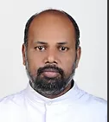
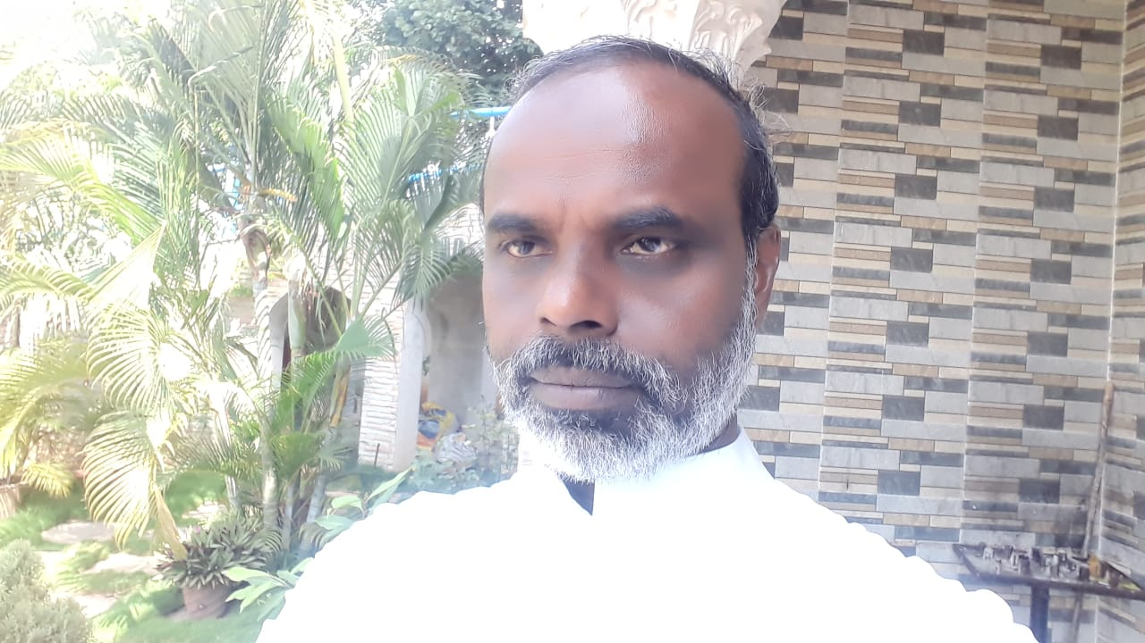
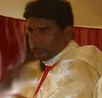
REGIONAL DRIVING FORCE
Fr. Joseph Sengole, Regional Director
Fr. John Churchil Bas, Assistant Regional Director,
Fr. Joans Cletus, Council Member
Mr. Rex Lourduraj and Mrs. Maria Purna Jeya, Committed Council Members

Slide 4

BEGINNING
6 Stability Priests Members
4 Professed Major Seminarians
30 Stability and Professed Committed Members
4 Teams: Madurai, Rameswaram, Chengulpet – Valarpuram and Chennai- Alandhur
2 Sectors: Madurai and Chennai.

Slide 5
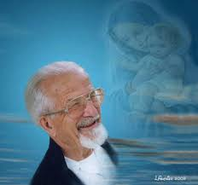
FR. PARENT ILLAM
Mr. Sanjeeviraj and Mrs. Mary, the God parents of Fr. John Churchil Bas for permitting us to use the piece of land and available construction in it for the formation house until we construct our own house.
      Fr. Joseph Sengole and Fr. Joans Cletus had borrowed INR 17 lakhs to renovate the existing structure
                July 15, 2017 blessed and inaugurated by Most. Rev. Dr. Antony Pappusamy, Archdiocese of Madurai @ Tamil Nadu.

Slide 6
MEMBERS
The Tamil Nadu Region is open to welcome the candidates who aspire to live the 5.5.5 Spirituality in creating Peace and Brotherhood in Jesus Christ following the model of Mother Mary.
27 Professed Priest Members, 26 Professed Major Seminarian and 47 Committed Members
PRIESTS 27
COMMITED MEMBERS 47
MAJOR SEMINARIANS 26

Slide 7
PRIEST MEMBERS
PROFESSED MEMBERS
Stability | Professed | Incardination in Diocese | Observation | Total
10 | 10 | 3 | 4 | 27
Course | First Year | Second Year | Third Year | Fourth Year | Total
Theology | 5 | 4 | 4 | 5 | 18
Philosophy | - | - | 5 | - | 5
Regent | 2 | - | - | - | 2
Deacon | 1 | - | - | - | 1
Total | 8 | 4 | 9 | 5 | 26
COMMITTED MEMBERS
Sl No | Team Name | Stability | Committed | Probation | Aspirancy | Total
1 | Rameswaram | 7 | - | 7 | - | 14
2 | Chengalpet - Valarpuram | - | - | 8 | 1 | 9
3 | Chennai-Alandhr | - | - | 3 | 8 | 11
4 | Chennai-Porur | - | - | - | 13 | 13
Total |  | 7 | - | 18 | 22 | 47

Slide 8
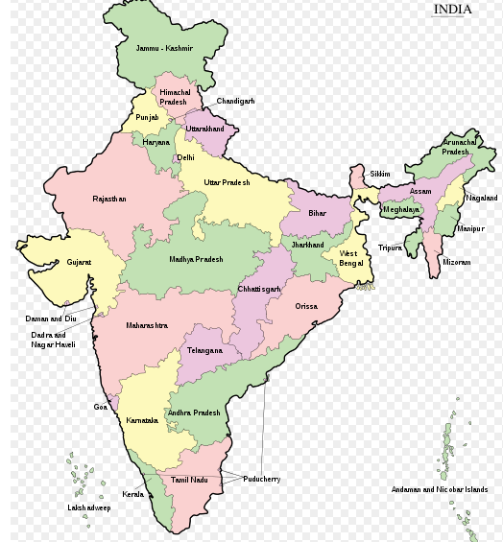
OUR PRESENCE IN INDIA
REGENCY FORMATION
Tamil Nadu
Karnataka
Andhra Pradesh
Goa
Maharashtra
Madhya Pradesh
Utter Pradesh
Telungana
Assam
Mizoram
Diocese of Bongaigaon @ Assam State,
Diocese of Eluru @ Andra Pradesh,
Diocese of Mysore @ Karnataka,
Diocese of Jhansi @ Madhya Pradesh and
Dioceses of Kuzhithurai, Kottar, Sivagangai, Coimbatore, Chengalpattu and Chennai – Mylapore @ Tamil Nadu State.

Slide 9

EDUCATION
Jnana Deep Vidyapeeth (JDV) @ Pune in Maharastra State,
St. Joseph Major Seminary @ Mangalore in Karnataka State,
Christhu Premelaya Seminary @ Bhopal in Utter Pradesh State,
Good Shepherd Seminary @ Coimbatore in Tamil Nadu State,
St. Paul’s Seminary @ Thiruchirapally in Tamil Nadu State and
Arul Anandher College @ Madurai in Tamil Nadu State.

Slide 10
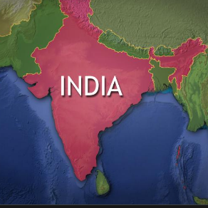
NATIONAL MINISTRY
Dioceses of Kuzhithurai, Kottar, Sivagangai, Thiruchirapally, Archdiocese of Chennai-Mylapore @ Tamil Nadu,
Diocese of Eluru @ Andhra Pradesh;
Archdiocese of Hyderabad @ Telungana and
Silchar Region in Assam State, belonging to Aizawl Diocese @ Mizoram.

Slide 11
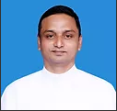
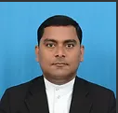
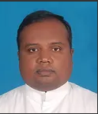
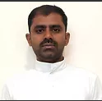
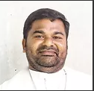

INTERNATIONAL MINISTRY
Fr. Allwyn Jesudass, (stability) Diocese of Asti @ North Italy.
Fr. Francis De Sales,(professed) Diocese of Asti @ North Italy.
Fr. Stephen (stability) Melbourne Diocese, Australia
Fr. John Bellarmine (Probation) Diocese of Lae @ Papua New Guinea, : appointed as the Chancellor of the Diocese of Lae and Director of Charismatic Movement in the Diocese
Fr. Jeyanel Justus (Probation) -Diocese of Lae @ Papua New Guinea
Fr. Jeyanthan, (professed) - Biloxi Diocese @ Mississippi State in the USA.
Fr. Agustin, (professed)- Archdiocese of Mobile @ Mississippi State in USA

Slide 12
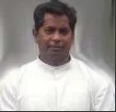
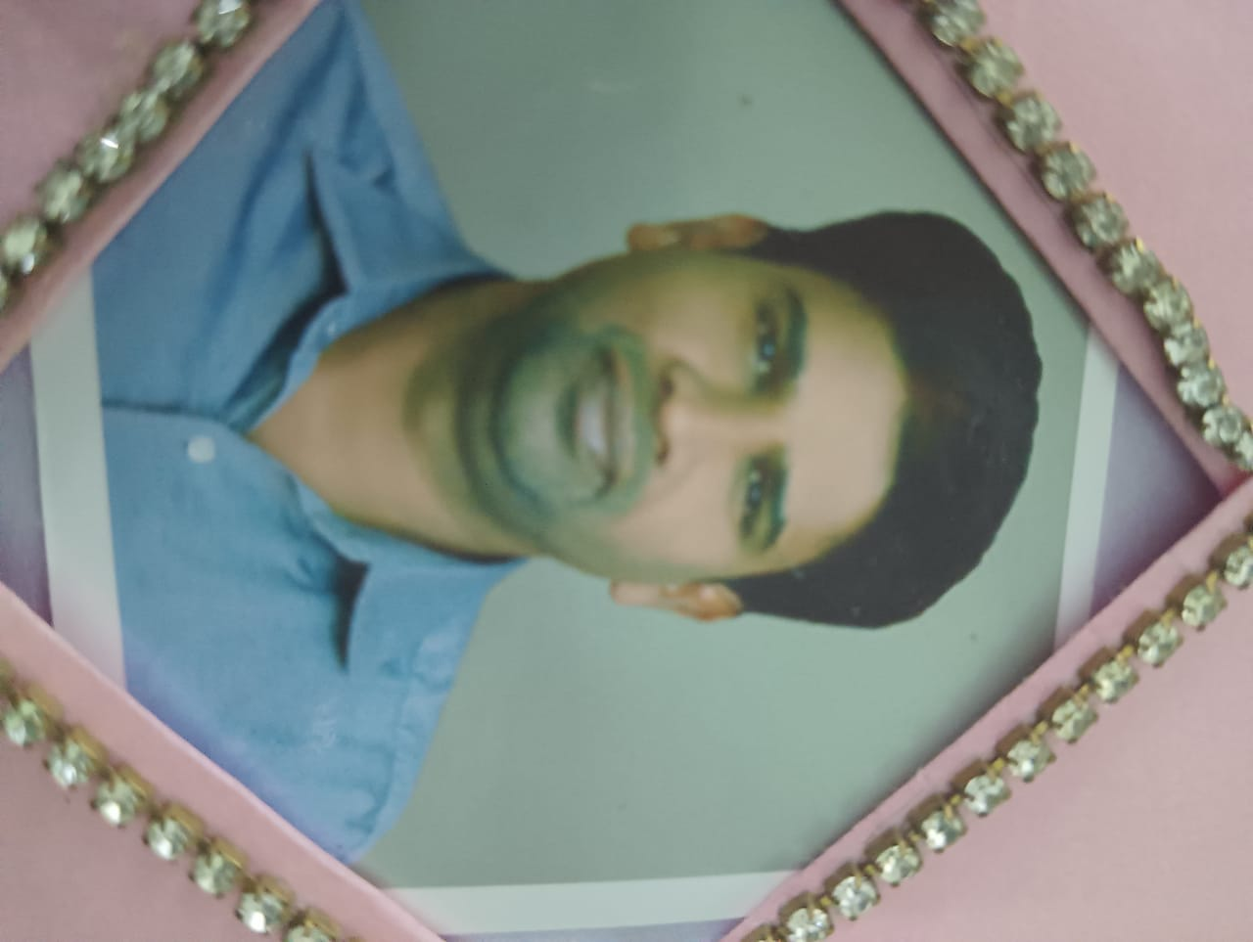
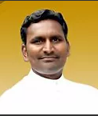
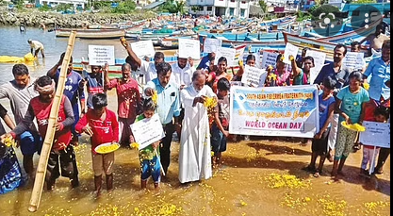
SECULAR MINISTRY
Fr. Joseph Sengole - charismatic conventional Retreat preaching,
- schools and colleges to motivate the students and youth.
Fr. John Churchil Bas – Serve fisher folk through South Asian Fishermen Fraternity (SAFF) as General Secretary
- an organization for Rescue, Release, Relief and Rehabilitation of stranded fishermen throughout the world.
Fr. Ignatius – Legal Ministry
Fr. Jones Cletus -Director for Scheduled Caste and Tribe Commission in the Diocese of Kuzhithurai.
Fr. Rajan Thomas - Doctoral studies in Social Work
Fr. Antony Samy - Teaching ministry in an Arts and Science College

Slide 13
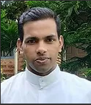
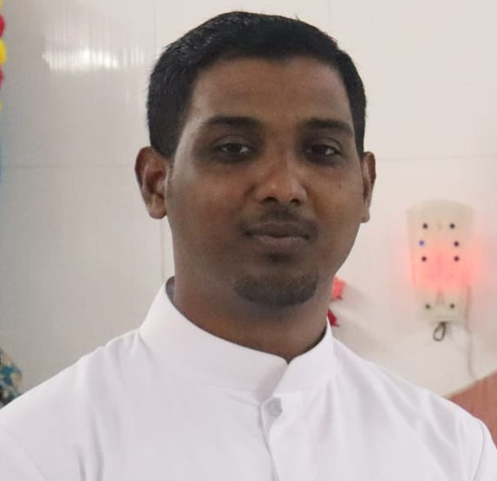
ORDINATION
Fr. Rajan Thomas (May 2018)
Fr. Allwyn Jesudhas (January 2021),
Fr. Arockiya Pradeep (January 2021)
Fr. Jobin (April 2022).

Slide 14
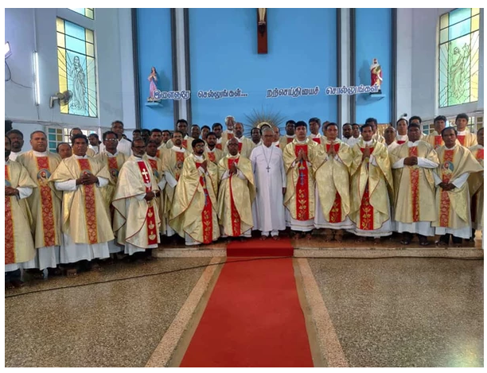
INCARDINATION IN DIOCESE
Fr. Naveen Talluri (Professed) January 2021 -Diocese of Eluru @ Telungana
Fr. Antony Samy (Professed) January 2021- Aizawl Diocese @ Mizoram
Fr. Antony Lobo (Professed) January 2021- Aizawl Diocese @ Mizoram.
Fr. Rajesh Nitta (Professed) July 2022- Diocese of Eluru @ Andhra Pradesh.

Slide 15
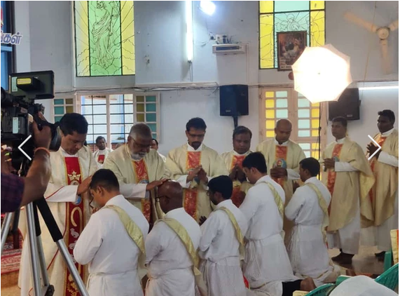
BLESSING AHEAD
Five Professed members have completed their Philosophical and Theological studies and renewed the vows for third time and have requested for special exemption for Priestly Ordination.

Slide 16
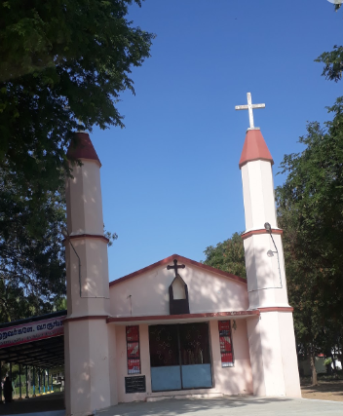
REGIONAL ADMINISTRATION HOUSE
Regional House at Vetha Pothagar Church campus in May 2021
We are grateful to the Diocese of Sivagangai for permitting us to use one of their pilgrimage centres, Vedha Pothagar Church near Madurai

Slide 17
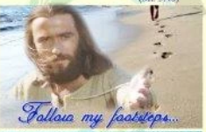
VOCATIONS
Being a young region accepted the candidates who approached with proper permission from their major superiors.
There are 10 professed and 04 probation priests candidates
2019 we are advised by the director general and his council not to promote any vocations further until stabilizing the existing members.

Slide 18

NECESSITY FOR MISSION
Priest need to be in mission for ministry.
Regional Director has to find place for mission of the members.
The Probationers and the professed members are sent to Papua New Guinea (PNG), Italy and Mississippi (USA)

Slide 19
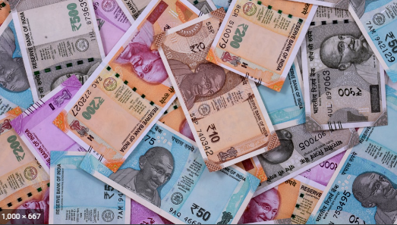
FINANCE
Contribution from the Central administration
All the mass stipends are contributed for institution’s Fund for the last 5 years.
Every month each priest member ( Probation, profession, and stability) contribute INR 1000 for seminarian fund.
Support from Donors and well wishers

Slide 20
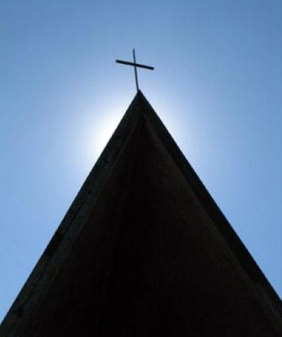
PLAN AHEAD…
Renewing our Secular character and our own identity as Voluntas.
Concentrating on the call of Celibate Laymen and Permanent Deacons
Focusing on Secular mission in the midst of the world.
Promoting the vocation of Associate members.
Finding possibilities to witness Jesus as working Priest.
Encouraging secular studies to candidates of priesthood

Slide 21

Could not receive contribution from central administration due to Indian Government’s restriction to receive the foreign Fund.
We manage the formation and mission with private loans.
We will repay the loan once we are able to receive the fund from central administration

Slide 22

TEAM LIFE
4 Teams meet regularly in respective places.
Seminarians have team meetings in their study centres.
Annual retreat, Christmas and the Easter celebrations are organized in sectors.

Slide 23
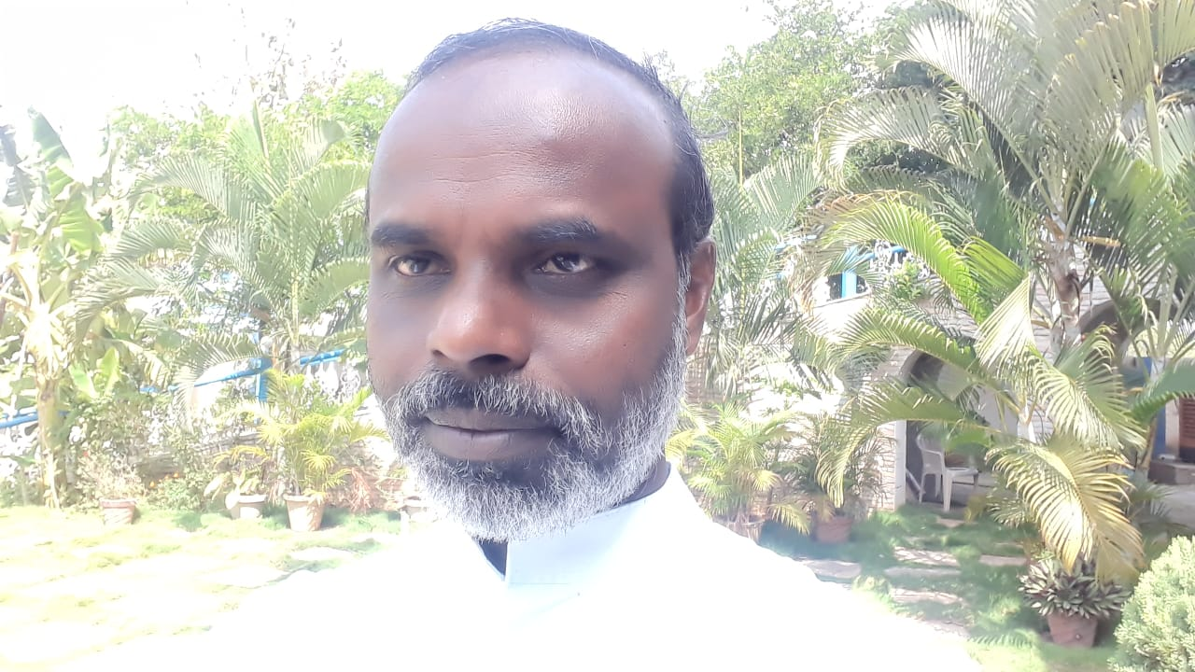
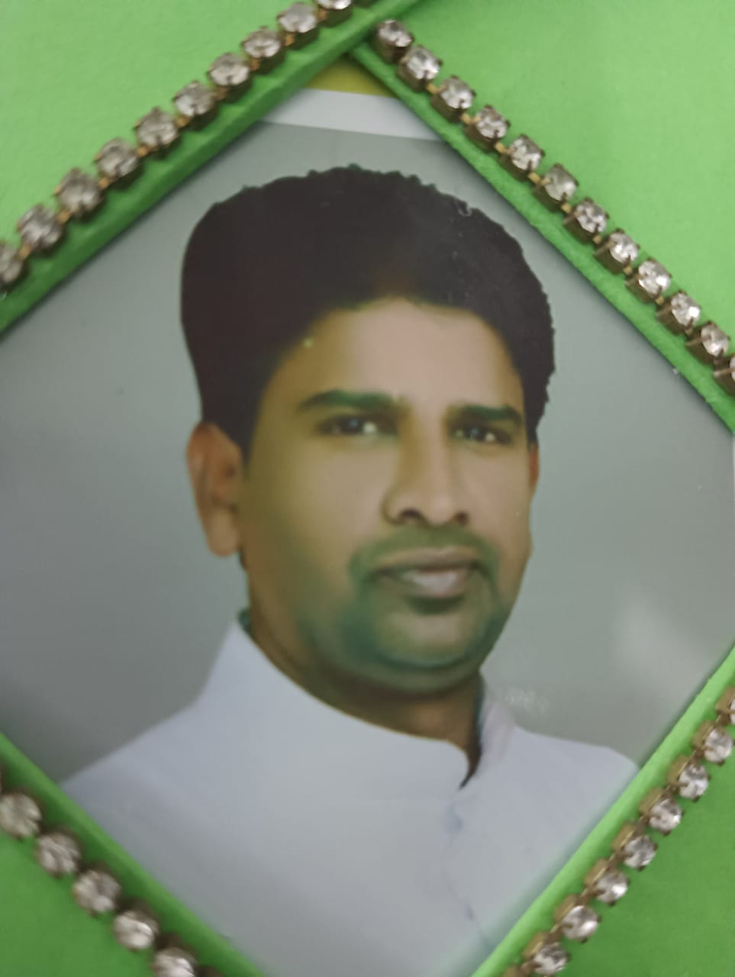
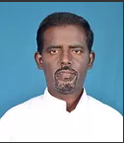
NEW REGIONAL COUNCIL
Fr. John Churchil Bas, Regional Director
Fr. Joans Cletus, Assistant Regional Director
Fr. Xavier Arockiyasamy, Council Member
Mr. Rex Lourduraj and Mrs. Maria Purna Jeya, Committed Council Members

Slide 24

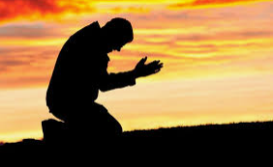
We acknowledge that we have failed to understand the nature of the authority that is being permitted by the constitution to the regions.
We have failed to abide by the rules in deciding upon sending missionaries (probationer and professed who receive indult) to abroad.
We should have avoid requesting local ordinaries regarding the incardination of the professed members without the prior approval of the Director General and his councillors.
We accept that we are misinterpreted and misunderstood by some church hierarchies in India

Slide 25
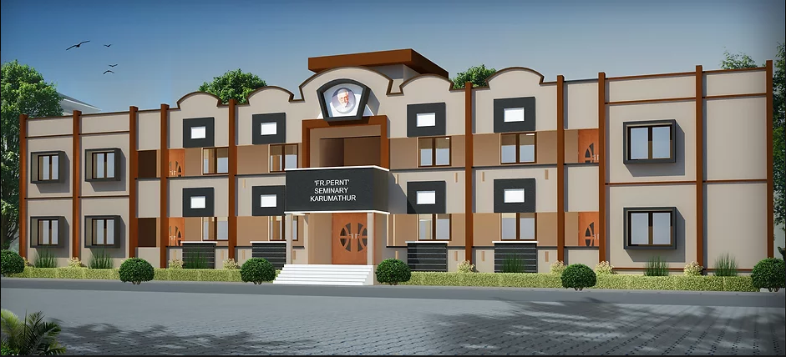
URGENT NEEDS OF REGION
Administration and Formation House
Vehicle for Transportation
We request the new Director General to visit our region at the earliest to rectify the irregularities in the administration.

Slide 26



WE THE TAMIL NADU REGION…
Thank god for giving us 5-5-5 Spirituality through our Founder Rev. Fr. Louis Marie Parent
Express our gratitude to very rev. fr. James Dunstan, director general and his council for all their guidence and assistants in leading us to walk in the foot steps of jesus.
Thank Voluntas Dei brothers and sisters for your prayers and concerns to find us peace and brotherhood in Jesus Christ.
Thank father Joseph Sengol for making us to follow the model of Mother Mary to do the Father’s will.
Thank the spiritual supporters, benefactors and well wishers for realizing us the act of charity.

